Slide 1

DevOps Fundamentals
Serhii Chernukha
TDF04

Slide 2
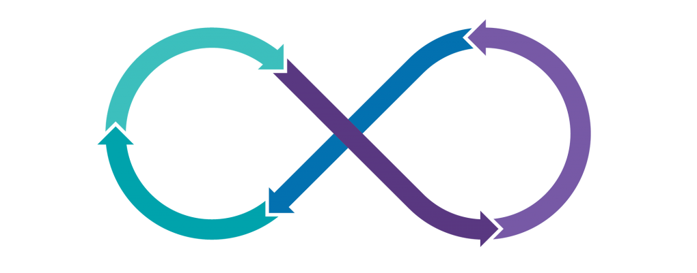

CI(Jenkins)

Slide 3

AGENDA
Introduction
What is Jenkins?
Jenkins Server
Jenkins Agents
Jenkins plugins
CLI client
Create new item
Jenkins Advantages

Slide 4
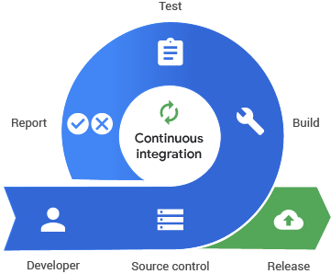
INTRODUCTION
CI
Continuous integration is a practice that encourages developers to integrate their code into a main branch of a shared repository early and often. Instead of building out features in isolation and integrating them at the end of a development cycle, code is integrated with the shared repository by each developer multiple times throughout the day.

Slide 5
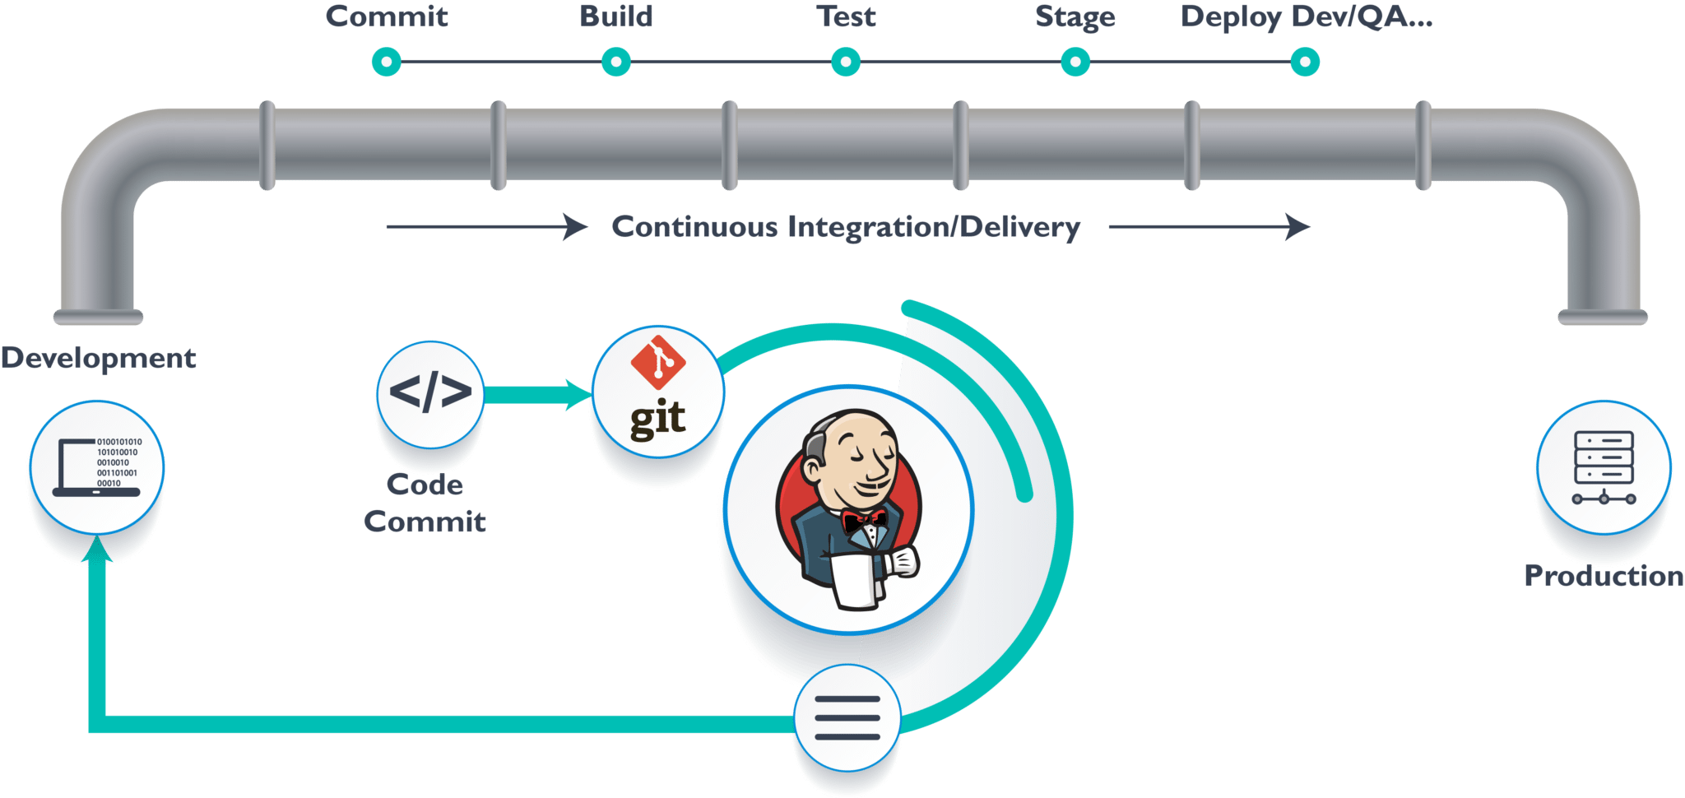

What is Jenkins?

Slide 6
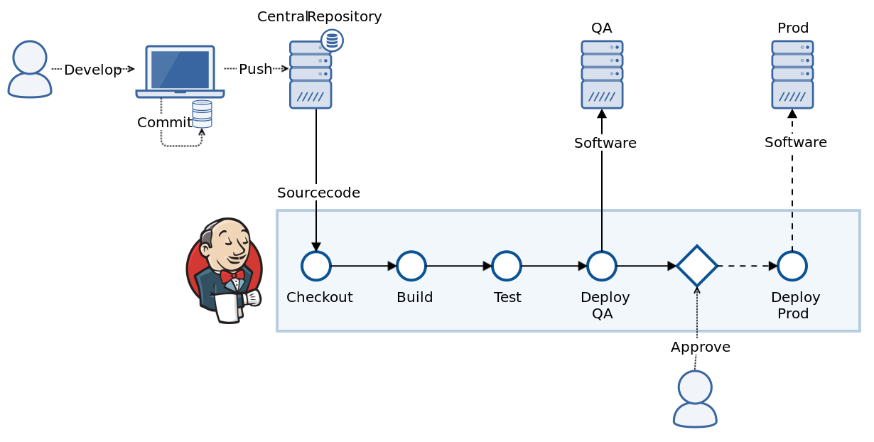
What is Jenkins?

Slide 7
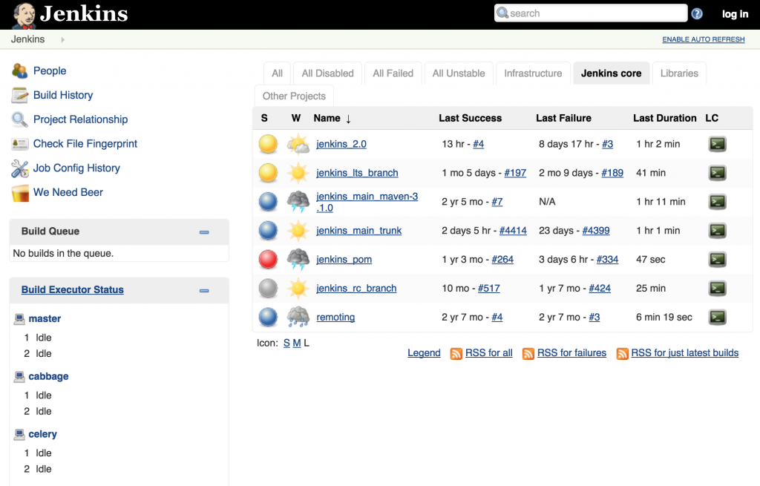
Jenkins Server
http://localhost:8080

Slide 8
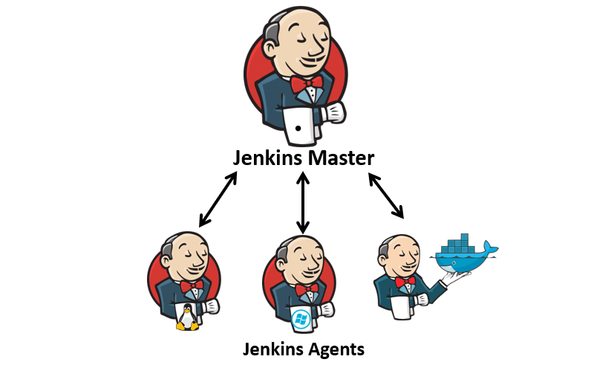
Jenkins Agents

Slide 9
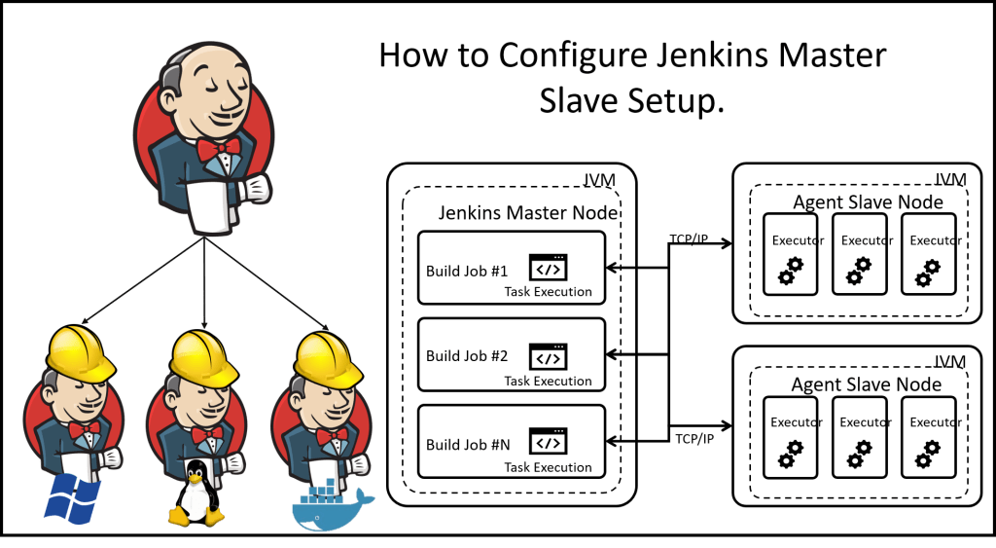
Jenkins Agents

Slide 10


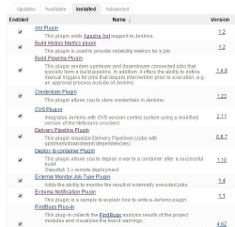
Jenkins plugins

Slide 11
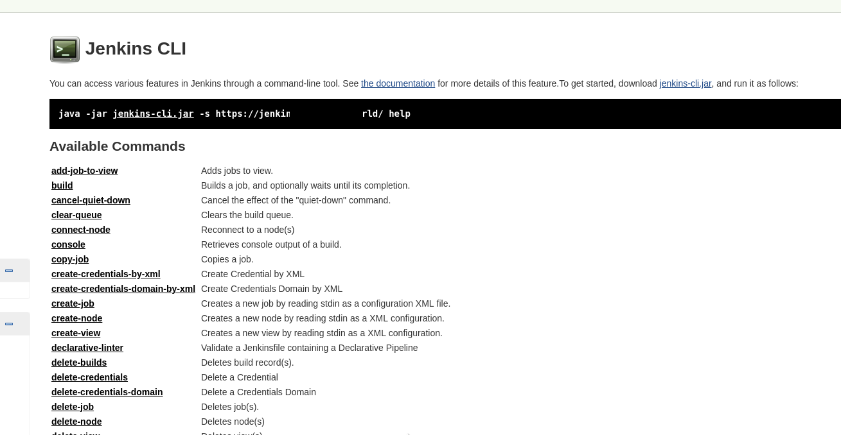
Jenkins CLI client

Slide 12
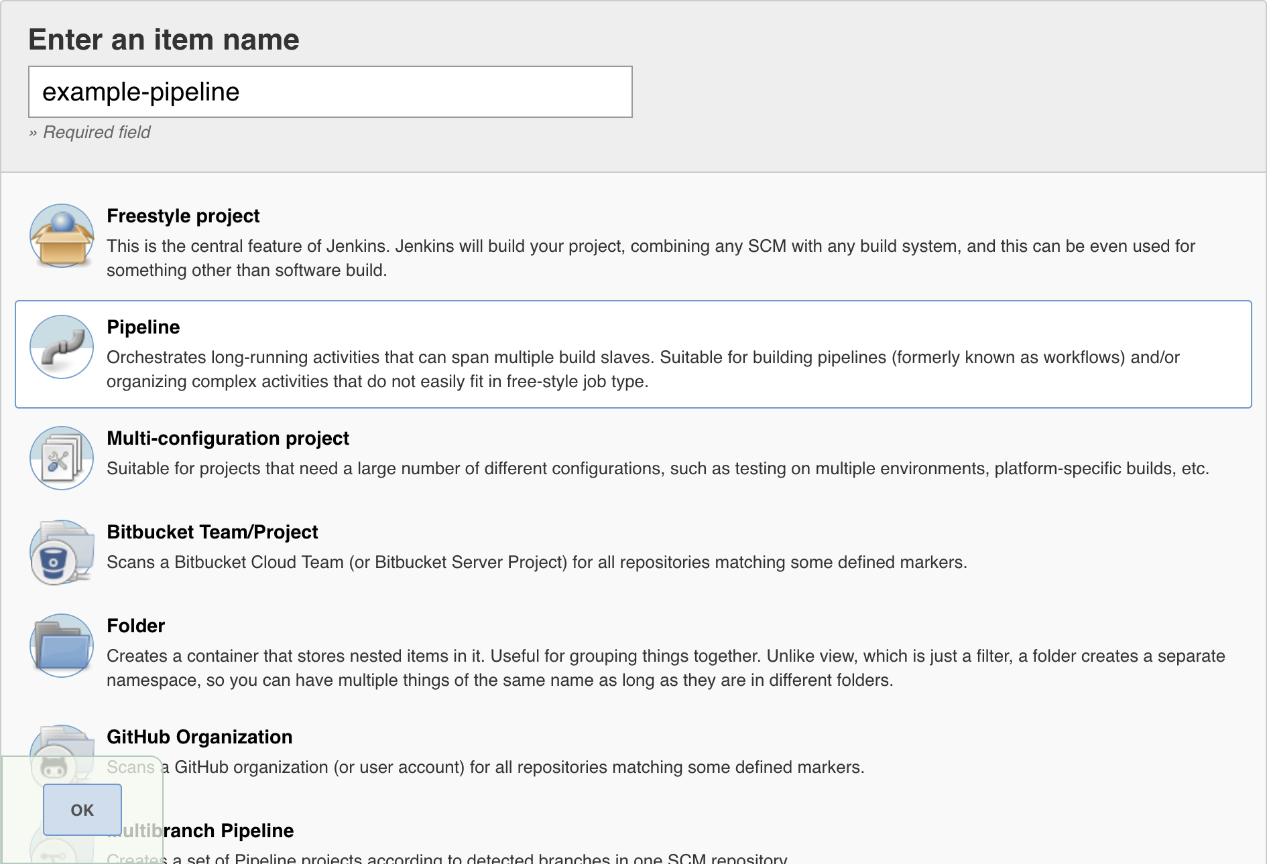
Create new item

Slide 13


Jenkins memes

Slide 14
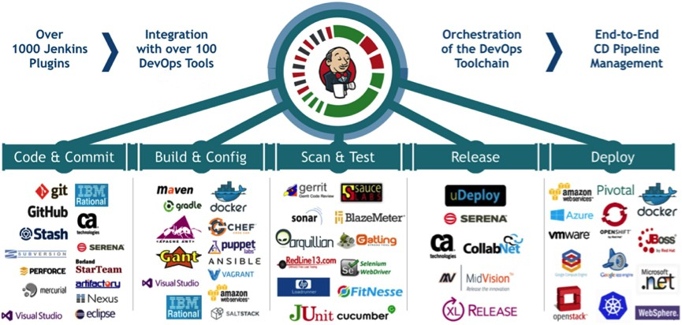
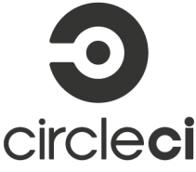


Jenkins
Jenkins Advantages
It is an open source tool with great community support.
It is easy to install.
It has 1000+ plugins to ease your work. If a plugin does not exist, you can code it and share with the community.
It is free of cost.
It is built with Java and hence, it is portable to all the major platforms.

Slide 15

DEMONSTRATION

Slide 16

Useful links:
https://www.softwaretestinghelp.com/devops-interview-questions/
https://www.softwaretestinghelp.com/jenkins-interview-questions/
https://www.youtube.com/watch?v=QKKbi6dWHZE
https://www.digitalocean.com/community/tutorials/how-to-install-jenkins-on-ubuntu-16-04
https://www.howtoforge.com/tutorial/ubuntu-jenkins-master-slave/
https://automationstepbystep.com/jenkins/
https://www.youtube.com/watch?v=sp_nEF5tdRM&list=PLg5SS_4L6LYvQbMrSuOjTL1HOiDhUE_5a&index=5

Slide 17

Thank You

